Slide 1
CENG401 MACHINE LEARNING AND ARTIFICIAL INTELLIGENCE
WEEK-3
INTELLIGENT AGENTS
Asst.Prof.Dr. Murat ŞİMŞEK

Slide 2
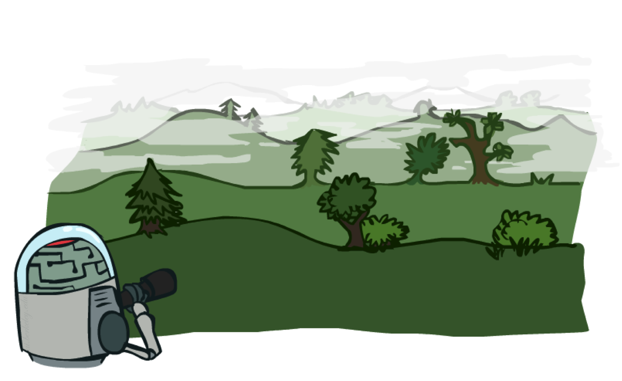
SOLVING PROBLEMS BY SEARCHING
This chapter describes one kind of goal-based agent called a problem-solving agent
Notes:
Intelligent agents are supposed to maximize their performance measure.

Slide 3

Search Problem
Under these assumptions, the solution to any problem is a fixed sequence of actions.
Notes:
Search Problems are our models for solving problems.

Slide 4

Search Problem
The process SEARCH of looking for a sequence of actions that reaches the goal is called search.
A search algorithm takes a problem as input and returns a solution in the form of an action sequence.
Notes:
Search Problems are our models for solving problems.

Slide 5

Search Problem
On holiday in Romania; currently in Arad.
Flight leaves tomorrow from Bucharest
Formulate goal:
be in Bucharest
Formulate problem:
states: various cities
actions: drive between cities
Find solution:
sequence of cities, e.g., Arad, Sibiu, Fagaras, Bucharest

Slide 6
Search Problem
A problem is defined by four items:
initial state e.g., "at Arad«
actions or successor function S(x) = set of action–state pairs
e.g., S(Arad) = {<Arad → Zerind, Zerind>, … }
goal test, can be
explicit, e.g., x = "at Bucharest"
implicit, e.g., Checkmate(x)
path cost (additive)
e.g., sum of distances, number of actions executed, etc.
c(x,a,y) is the step cost, assumed to be ≥ 0
A solution is a sequence of actions leading from the initial state to a goal state

Slide 7
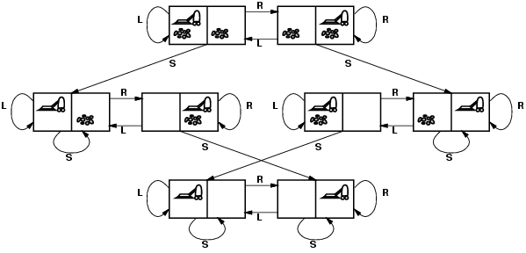
Search Problem
states?
actions?
goal test?
path cost?

Slide 8
Search Problem
states? integer dirt and robot location
actions? Left, Right, Suck
goal test? no dirt at all locations
path cost? 1 per action

Slide 9
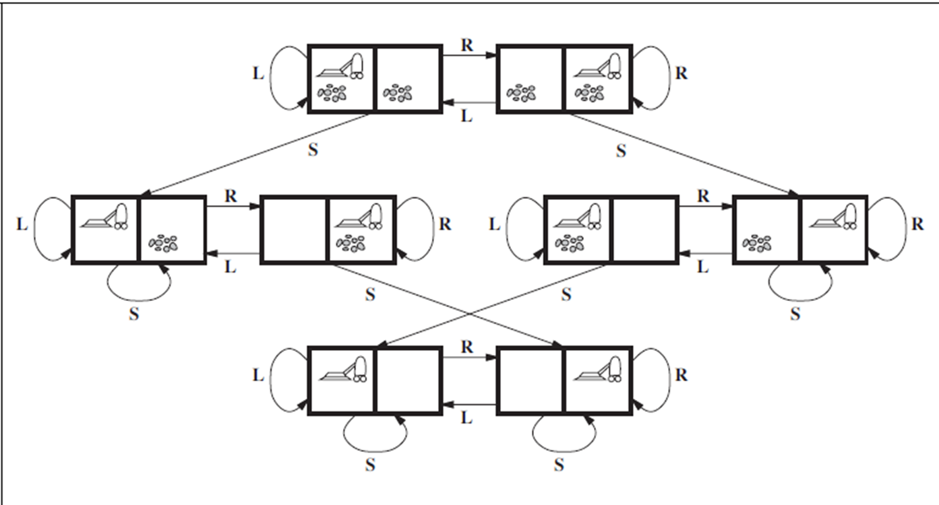
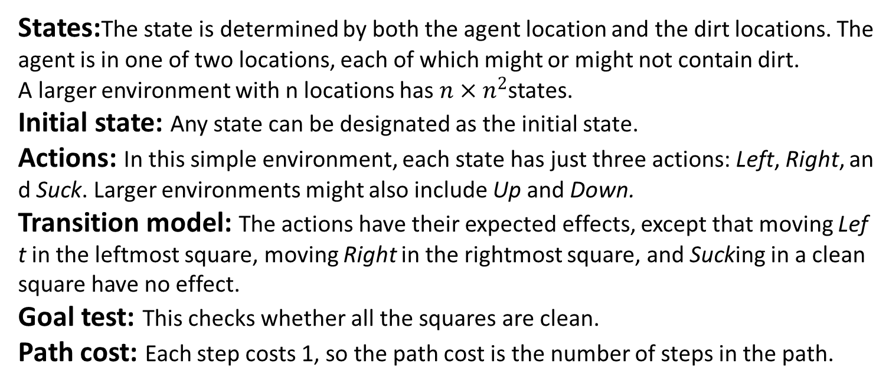
Formulating problems
States:The state is determined by both the agent location and the dirt locations. The
agent is in one of two locations, each of which might or might not contain dirt.
A larger environment with n locations has $n×n^{2}$states.
Initial state: Any state can be designated as the initial state.
Actions: In this simple environment, each state has just three actions: Left, Right, and Suck. Larger environments might also include Up and Down.
Transition model: The actions have their expected effects, except that moving Left in the leftmost square, moving Right in the rightmost square, and Sucking in a clean square have no effect.
Goal test: This checks whether all the squares are clean.
Path cost: Each step costs 1, so the path cost is the number of steps in the path.

Slide 10

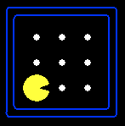

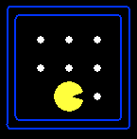



Search Problem
A search problem consists of:
A state space
A successor function
(with actions, costs)
A start state and a goal test
A solution is a sequence of actions (a plan) which transforms the start state to a goal (final) state
“N”, 2.0
“E”, 2.0

Slide 11
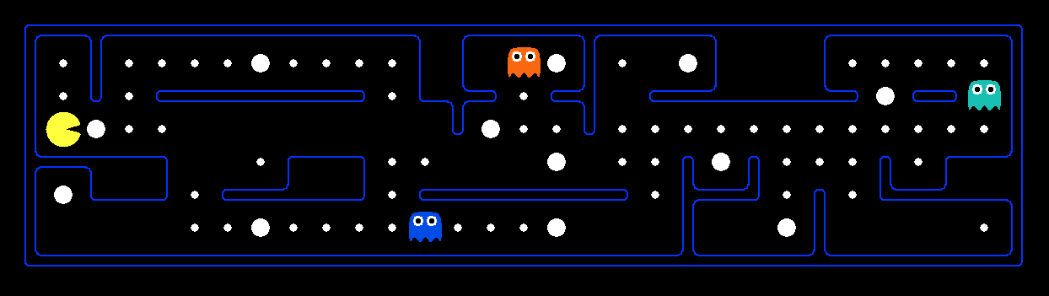
What’s in a State Space?
The world state includes every last detail of the environment
Problem: Pathing
States: (x,y) location
Actions: NSEW
Successor: update location only
Goal test: is (x,y)=END
Problem: Eat-All-Dots
States: {(x,y), dot booleans}
Actions: NSEW
Successor: update location and possibly a dot boolean
Goal test: dots all false

Slide 12
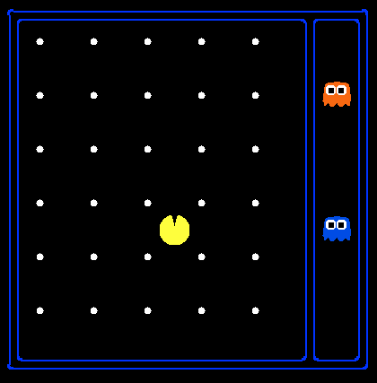
State Space Sizes?
World state:
Agent positions: 120
Food count: 30
Ghost positions: 12
Agent facing: NSEW
How many
World states?
120x(2³⁰)x(12²)x4
States for pathing?
120
States for eat-all-dots?
120x(2³⁰)

Slide 13
State Space Graphs
a
G
b
c
e
d
f
S
h
p
r
q
Tiny search graph for a tiny search problem

Slide 14
State Space Graphs
State space graph: A mathematical representation of a search problem
Nodes are (abstracted) world configurations
Arcs represent successors (action results)
The goal test is a set of goal nodes (maybe only one)
In a state space graph, each state occurs only once!
We can rarely build this full graph in memory (it’s too big), but it’s a useful idea

Slide 15
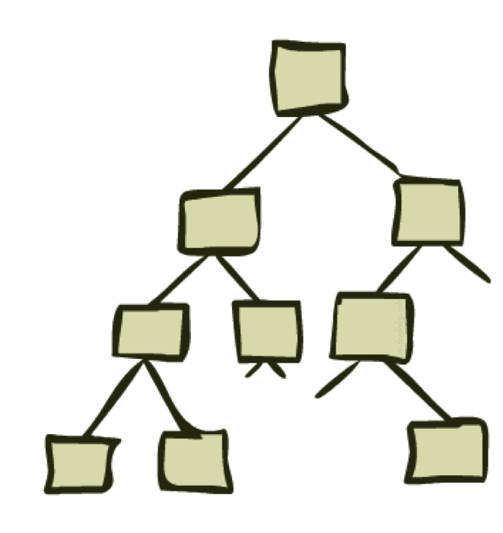
Search Trees

Slide 16
Search Trees
This is now / start
“N”, 1.0
“E”, 1.0
Possible futures
A search tree:
A “what if” tree of plans and their outcomes
The start state is the root node
Children correspond to successors
Nodes show states, but correspond to PLANS that achieve those states
For most problems, we can never actually build the whole tree
Notes:
Different plans that achieve the same state, will be different nodes in the tree.

Slide 17
State Space Graphs vs. Search Trees
State Space Graph
Each NODE in the search tree is an entire PATH in the state space graph.
Search Tree
S
a
G
d
e
p
b
c
q
b
c
e
h
r
d
e
f
a
a
h
r
p
q
f
S
h
We construct both on demand – and we construct as little as possible.
p
q
f
q
c
G
p
q
r
q
c
G
a
a

Slide 18
Uninformed search strategies
Depth-first search
Breadth-first search
Uniform-cost search
Notes:
Different plans that achieve the same state, will be different nodes in the tree.

Slide 19

Depth-First Search
Depth-first search is a recursive algorithm for traversing a tree or graph data structure.
It is called the depth-first search because it starts from the root node and follows each path to its greatest depth node before moving to the next path.

Slide 20
Depth-First Search
Strategy: expand a deepest node first
a
G
a
c
b
c
b
e
d
e
d
f
f
S
h
h
p
p
r
q
r
q
S
d
e
p
b
c
e
h
r
q
a
a
h
r
p
q
f
p
q
f
q
c
G
q
c
G
a
a

Slide 21
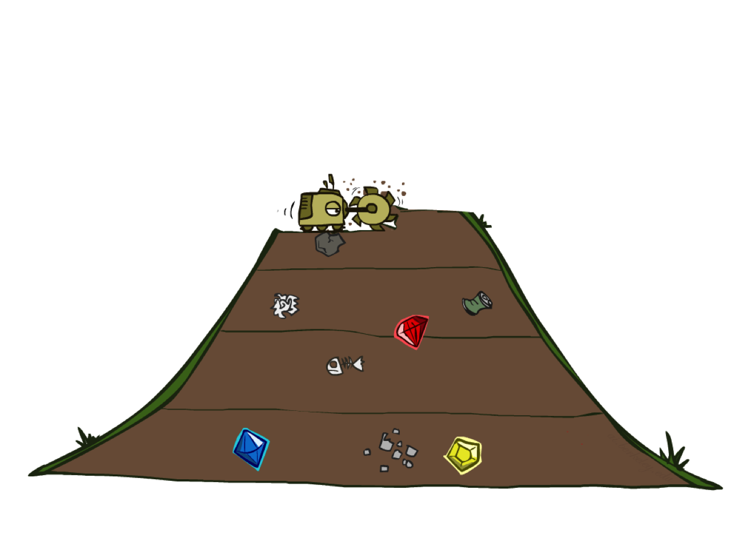
Breadth-First Search
Breadth-First Search (BFS) is an algorithm used for traversing or searching tree or graph data structures.
It starts at the root node and explores all the neighbor nodes at the current depth level before moving on to nodes at the next depth level.

Slide 22
Breadth-First Search
Strategy: expand a shallowest node first
a
G
b
c
d
e
f
S
h
p
q
r
S
d
e
p
Search
Tiers
b
c
e
h
r
q
a
a
h
r
p
q
f
p
q
f
q
c
G
q
c
G
a
a

Slide 23
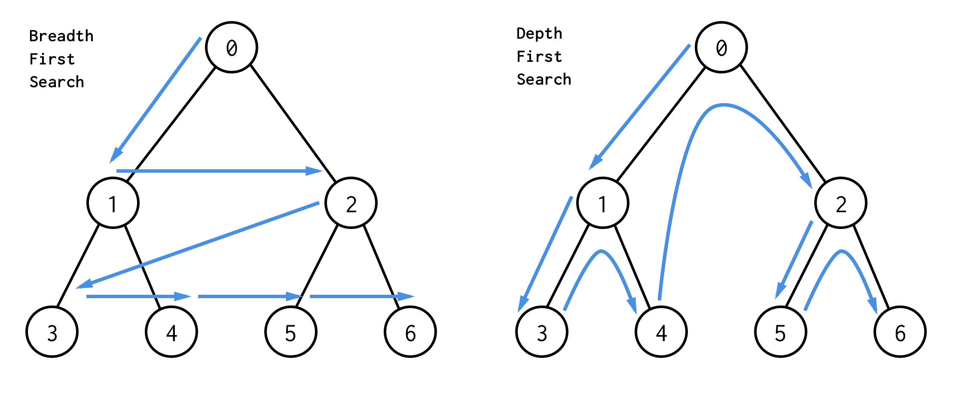
DFS vs BFS

Slide 24
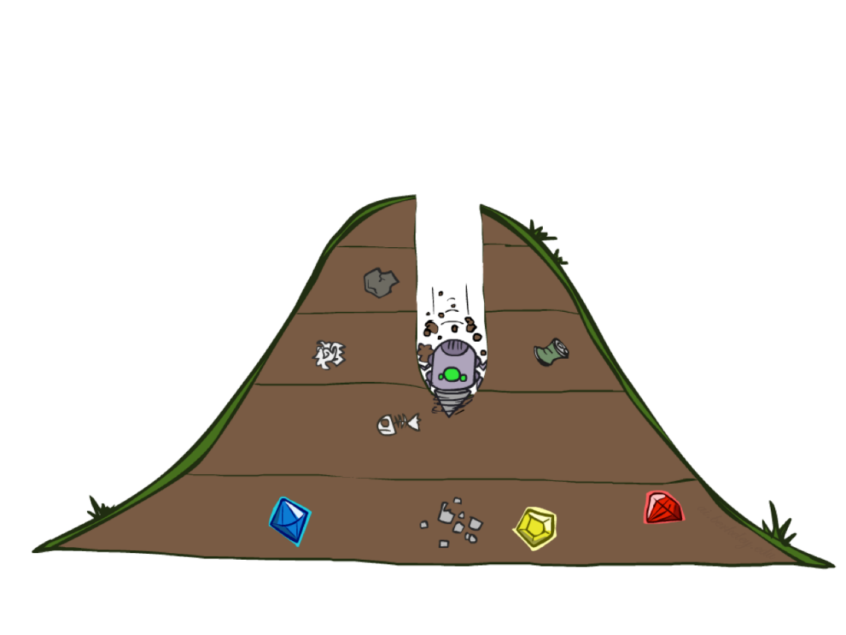
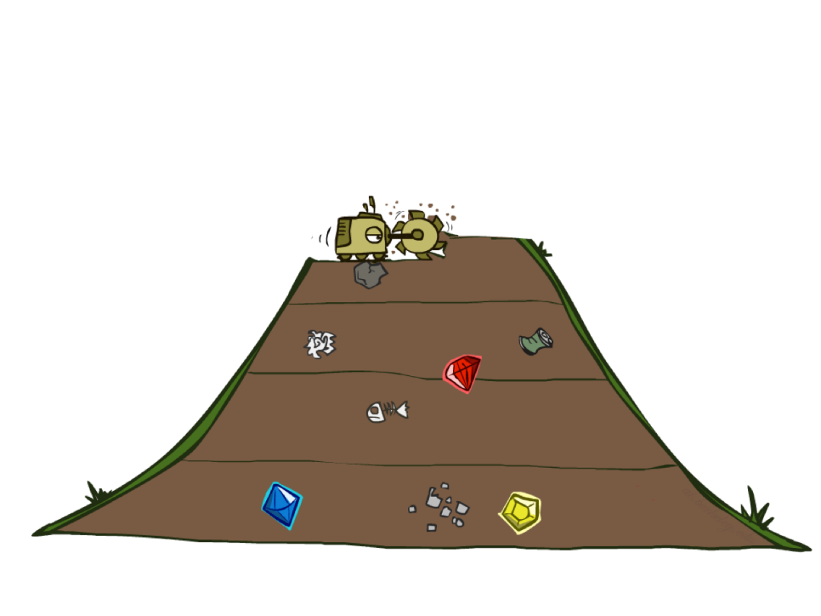
Quiz: DFS vs BFS

Slide 25

Video of Demo Maze Water DFS/BFS (part 1)
Notes:
BFS

Slide 26
Video of Demo Maze Water DFS/BFS (part 2)
Notes:
DFS

Slide 27
Cost-Sensitive Search
a
GOAL
2
2
b
c
3
2
1
8
2
e
d
f
3
9
8
2
START
h
1
4
2
p
4
r
15
q
BFS finds the shortest path in terms of number of actions.
It does not find the least-cost path. We will now cover
a similar algorithm which does find the least-cost path.

Slide 28

Uniform Cost Search
Uniform Cost Search (UCS) is a graph search algorithm used to find the shortest path from a starting node to a goal node in a weighted graph.
UCS explores nodes in a manner similar to Breadth-First Search (BFS), but it takes into account the cost associated with each edge in the graph.
The algorithm always selects the node with the lowest path cost from the starting node to that particular node, which makes it "uniform" in terms of cost.

Slide 29
Uniform Cost Search
2
G
a
Strategy: expand a cheapest node first
b
c
1
8
2
2
e
3
d
f
9
8
2
S
h
1
1
p
q
r
15
0
S
d
3
e
9
p
1
b
4
e
5
h
17
r
11
q
16
c
11
Cost contours
a
6
a
h
13
r
7
p
q
f
p
q
f
8
q
c
G
q
c
a
11
G
10
a

Slide 30
Video of Demo Empty UCS

Slide 31
Video of Demo Maze with Deep/Shallow Water --- DFS, BFS, or UCS? (part 1)
Notes:
Let students guess which one of the three it is. (This is BFS.)

Slide 32
Video of Demo Maze with Deep/Shallow Water --- DFS, BFS, or UCS? (part 2)
Notes:
Let students guess which one of the three it is. (This is UCS.)

Slide 33
Video of Demo Maze with Deep/Shallow Water --- DFS, BFS, or UCS? (part 3)
Notes:
Let students guess which one of the three it is. (This is DFS.)

Slide 34
Recap: Search
Search problem:
States (configurations of the world)
Actions and costs
Successor function (world dynamics)
Start state and goal test
Search tree:
Nodes: represent plans for reaching states
Plans have costs (sum of action costs)
Search algorithm:
Systematically builds a search tree
Chooses an ordering of the fringe (unexplored nodes)
Optimal: finds least-cost plans

Slide 35
End of the Week…

